Slide 1
Programming Study Align Algorithm
NAM SOFTWARE
2017

Slide 2
Geometric model - Coordinates
Coordinates
{C}
Camera
{L}
Laser head
{S}
Stage
Mark
{G}
Glass
{W}
World coordinate

Slide 3
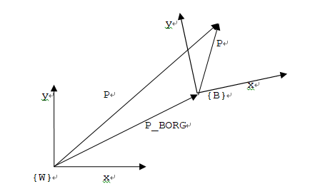
Coordinate Transform

Slide 4
Geometric model – camera
Camera Assembly to World
Mark position
w.r.t camera pixel
Pixel to Camera
Mark position w.r.t World
Camera to Camera Assembly

Slide 5
Geometric model – stage
Servo to World
Stage to Servo
GlassCenter to GlassLoading
Mark position w.r.t World
Mark position w.r.t Glass
GlassLoading to Stage
Glass to GlassCenter

Slide 6
Camera matrix
Resolution mm/pixel
Width, Height

Slide 7
Calibration – finding camera offset
target
Mark at the stage

Slide 8
Least Square Method

Slide 9
Calibration – glass
target

Slide 10
Servo control to mark

Slide 11
Calibration error

Slide 12
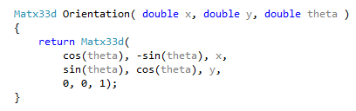
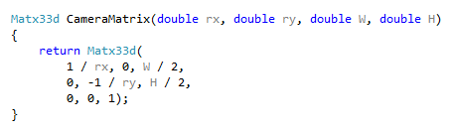
OpenCV matrix operation

Slide 13
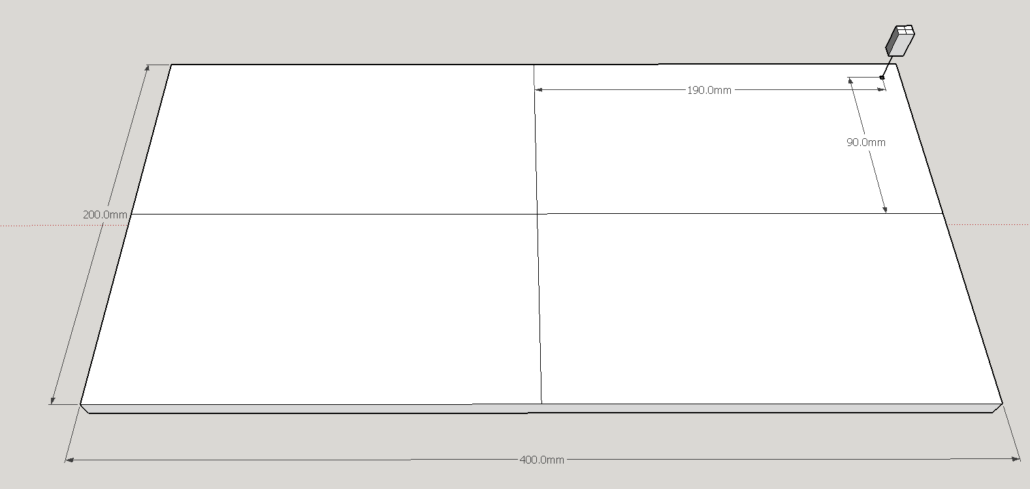
Camera, Stage and reference mark

Slide 14
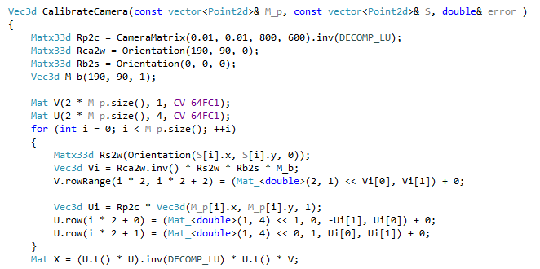
Calibrate Camera

Slide 15
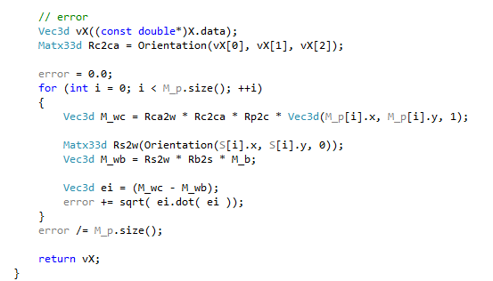
Error check

Slide 16
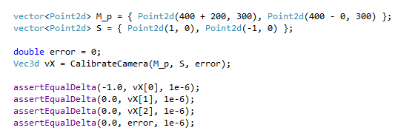
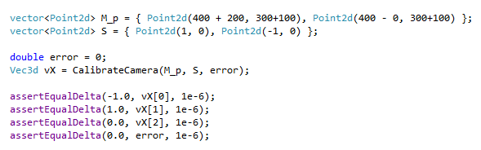
Cases

Slide 17
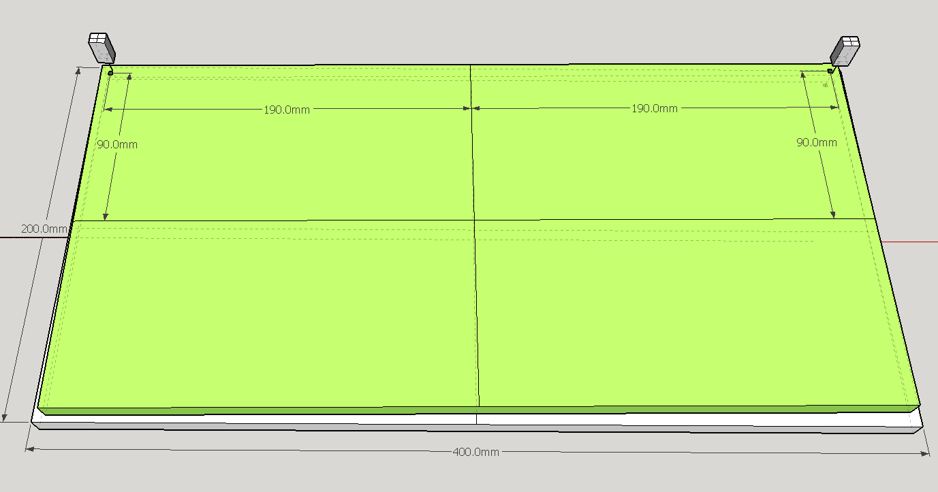
Camera, Stage and Glass

Slide 18
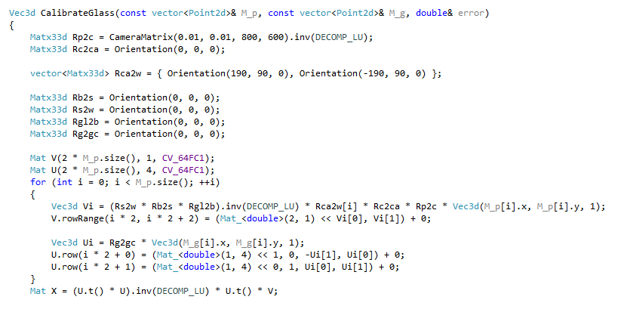
Calibrate Glass

Slide 19
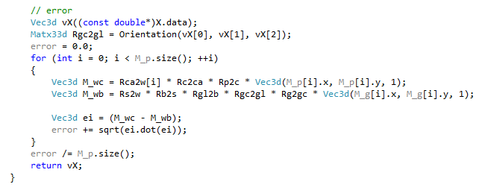
Calibrate Glass

Slide 20
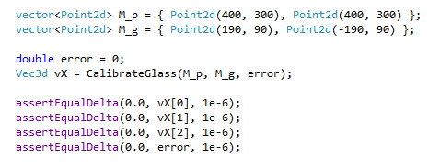
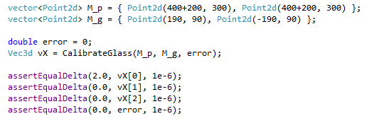
Cases

